Slide 1
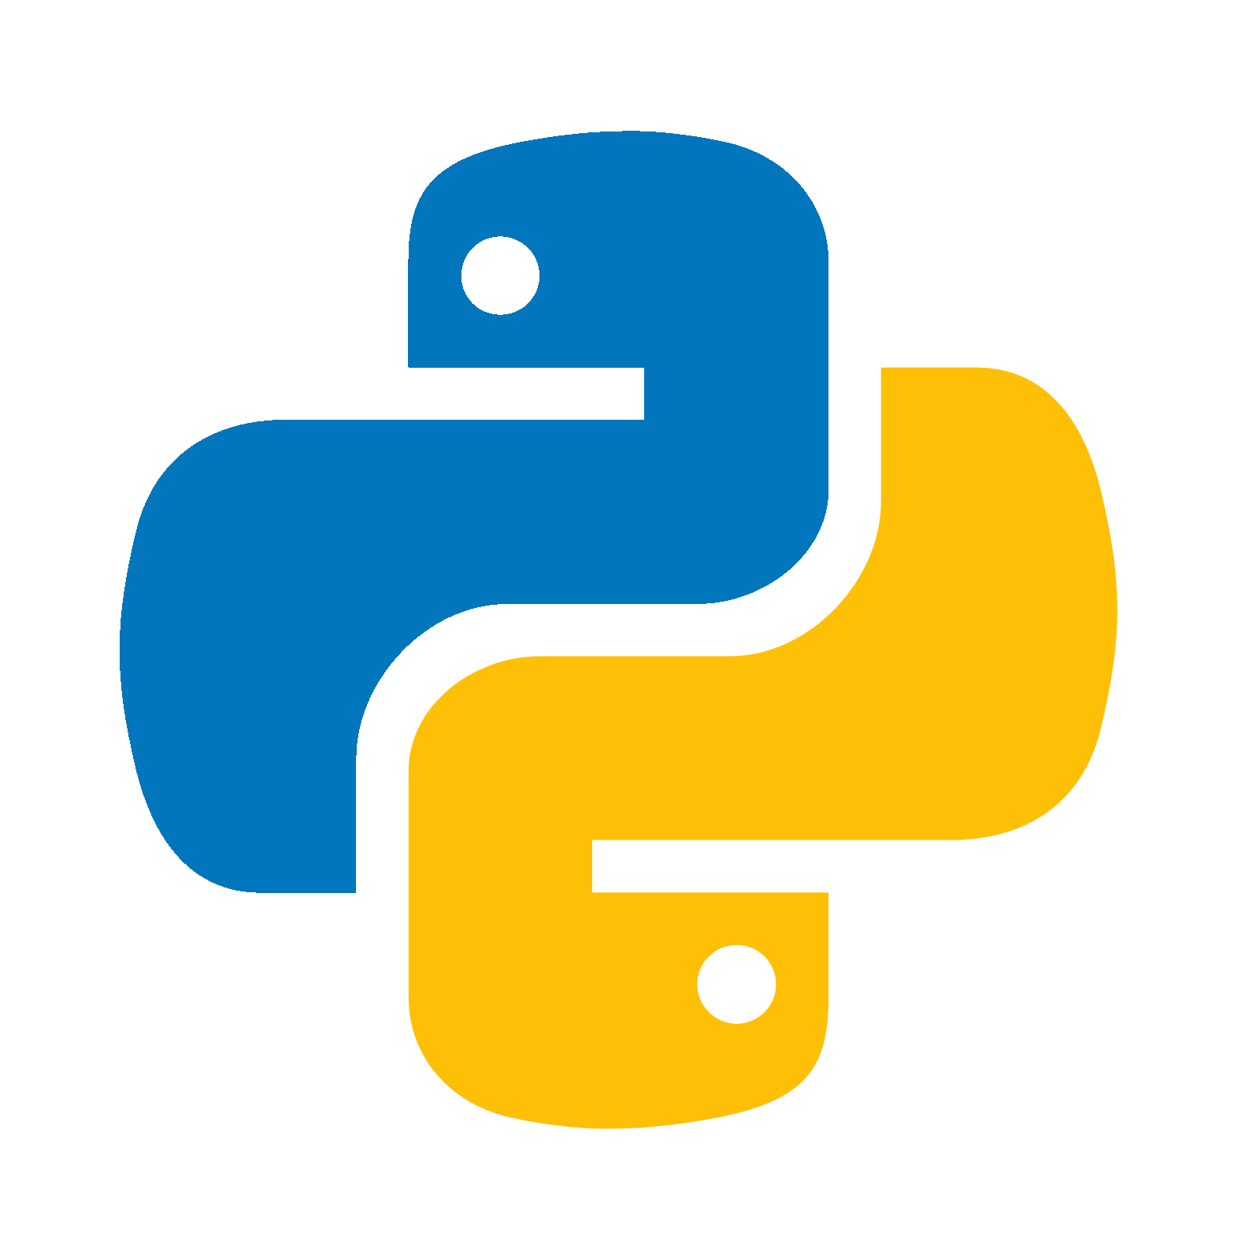
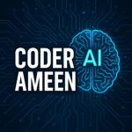
Introduction to Python

Slide 2
What is Python
Python is a high-level Interpreter, general-purpose programming language known for its simplicity, readability, and versatility.
Readable & Clean Syntax: Almost like writing English.
Interpreted & Dynamically Typed: No need to declare variable types.
Huge Standard Library: Comes with modules for everything from web development to math.
Cross-Platform: Runs on Windows, macOS, Linux, etc.
Supports Multiple Paradigms: Object-oriented, procedural, and functional programming.
Open Source and Large community: Free to use and large amount of community to contribute and collabarate.

Slide 3
2. Setting up Python and IDEs
Installing Python
1. Download and Install Python
1. Visit the official Python webiste: https://www.python.org/.
2. Run the Installer and ensure you check the box to Add python to PATH (important for running Python from the command line).
2. Verify Installation:
1. Open a terminal or command prompt and type:
python --version
Note: This should display the installed python version (e.g., Python 3.13.5)

Slide 4
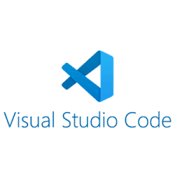
2. Setting up Python and IDEs
What is IDE
An Integrated Development Environment (IDE) is a software application that provides tools for writing, testing and debugging code.
Popular Python IDEs
1. VS Code
2. PyCharm
3. Jupyter Notebook
4. IDLE
5. Sublime
6. Brackets
Download link for VS Code: https://code.visualstudio.com/download

